Slide 1
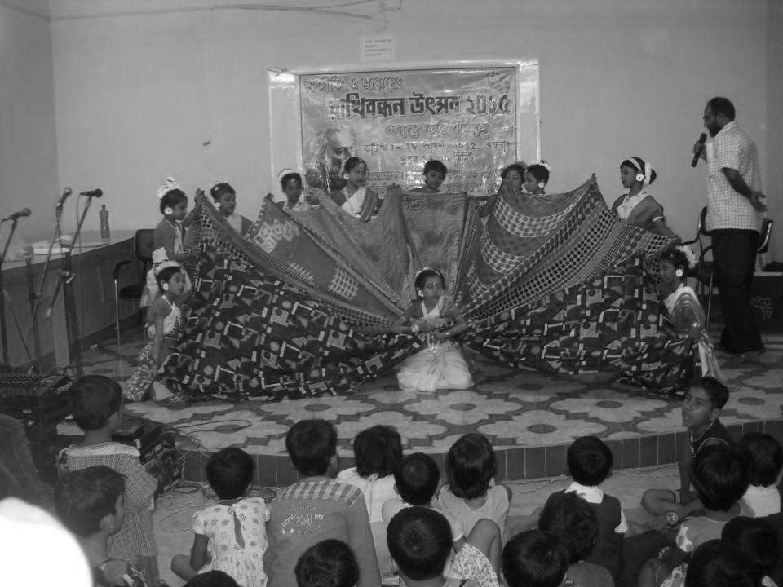
SWANIRVAR PRIMARY EDUCATION DEPARTMENT INTERVENTION IN GOVT SCHOOLS – 2015-16

Slide 2
SWANIRVAR INTERVENTION IN GOVT SCHOOLS – 2015-16
117 Schools
400+ Govt Teachers
10000+ Children
ACTIVITIES IN PICTURES
IN 2015( January- December)

Slide 3
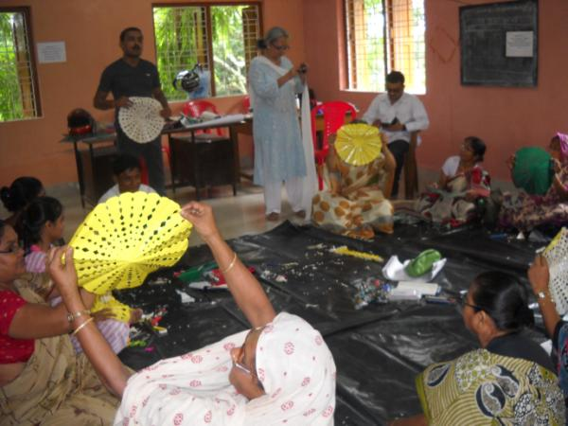
SWANIRVAR INTERVENTION IN GOVT SCHOOLS – 2015-16
Art & Craft Training with Govt teachers

Slide 4
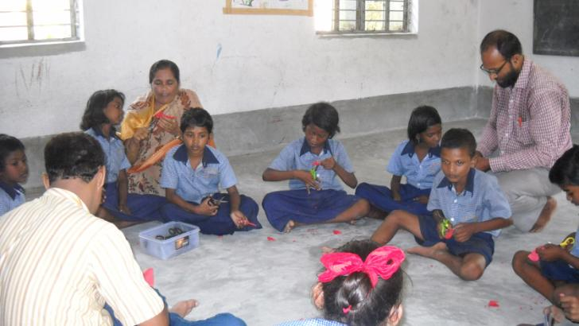
SWANIRVAR INTERVENTION IN GOVT SCHOOLS – 2015-16
Art & Craft Training with Children

Slide 5
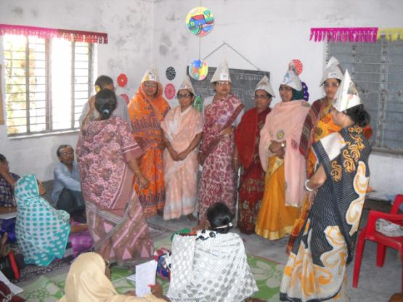
SWANIRVAR INTERVENTION IN GOVT SCHOOLS – 2015-16
Subject Training to Govt Teachers

Slide 6
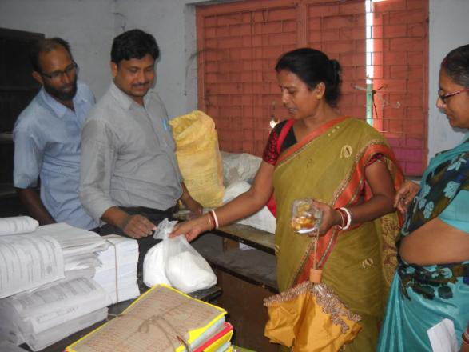
SWANIRVAR INTERVENTION IN GOVT SCHOOLS – 2015-16
Distribution of Lime & Bleaching powder to 60 Water logged SSK schools

Slide 7
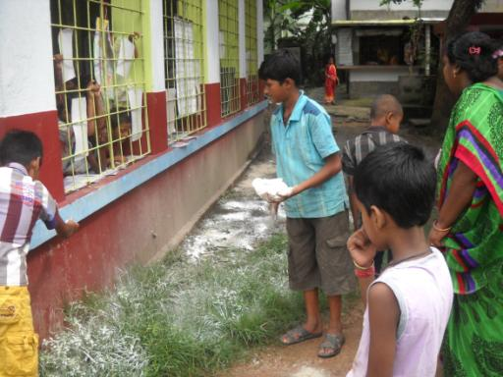
SWANIRVAR INTERVENTION IN GOVT SCHOOLS – 2015-16
Disinfection school campus after flood

Slide 8
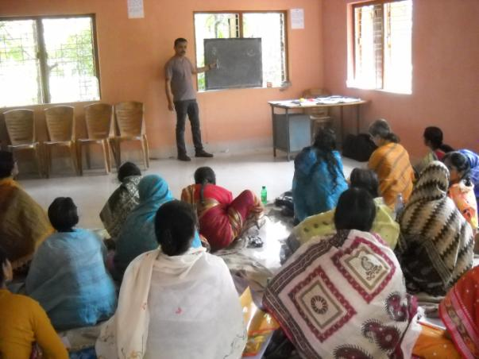
SWANIRVAR INTERVENTION IN GOVT SCHOOLS – 2015-16
Language training to Govt Teachers

Slide 9
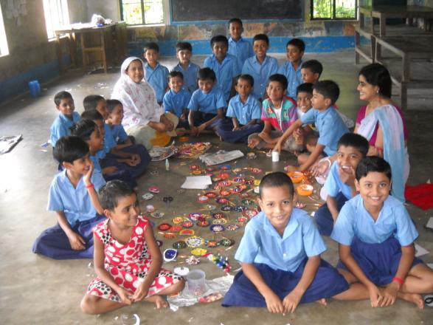
SWANIRVAR INTERVENTION IN GOVT SCHOOLS – 2015-16
Rakhi made by the children

Slide 10
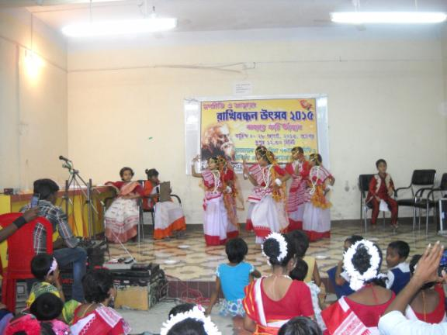
SWANIRVAR INTERVENTION IN GOVT SCHOOLS – 2015-16
Rakhi & Cultural activities with Children in Govt Schools

Slide 11
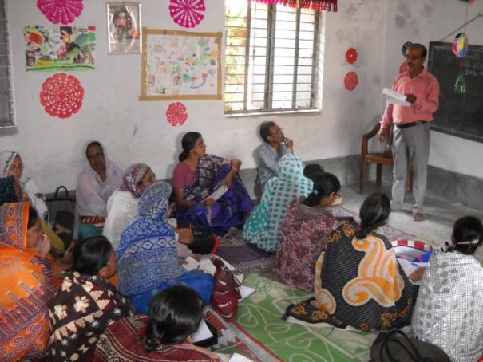
SWANIRVAR INTERVENTION IN GOVT SCHOOLS – 2015-16
Language training with Govt Teachers

Slide 12
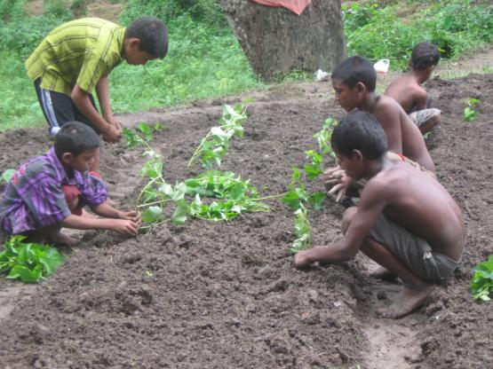
SWANIRVAR INTERVENTION IN GOVT SCHOOLS – 2015-16
Hands on training with children in Juvenile Correctional Home

Slide 13
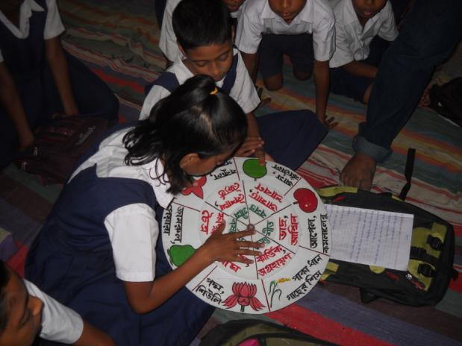
SWANIRVAR INTERVENTION IN GOVT SCHOOLS – 2015-16
Group work and TLM use

Slide 14
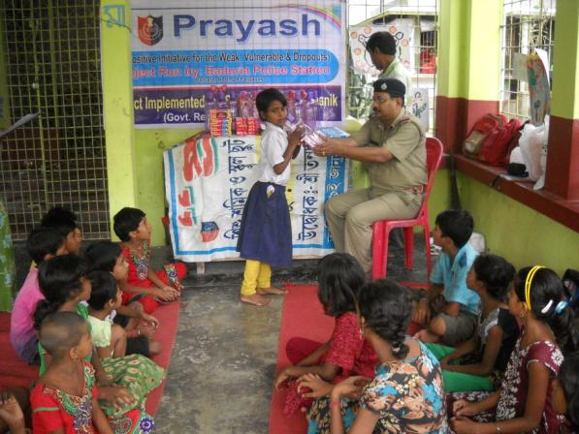
SWANIRVAR INTERVENTION IN GOVT SCHOOLS – 2015-16
Book distributions in Police station school

Slide 15
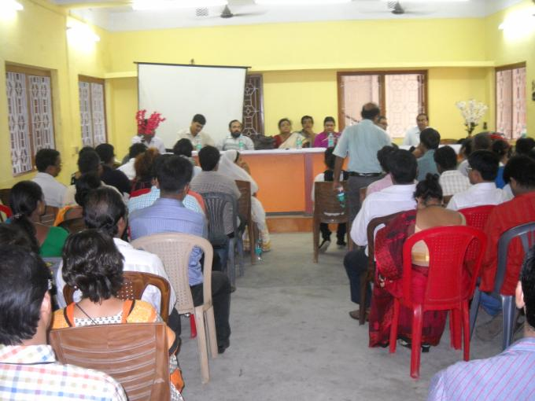
SWANIRVAR INTERVENTION IN GOVT SCHOOLS – 2015-16
Training to Govt officials via SIPRD

Slide 16
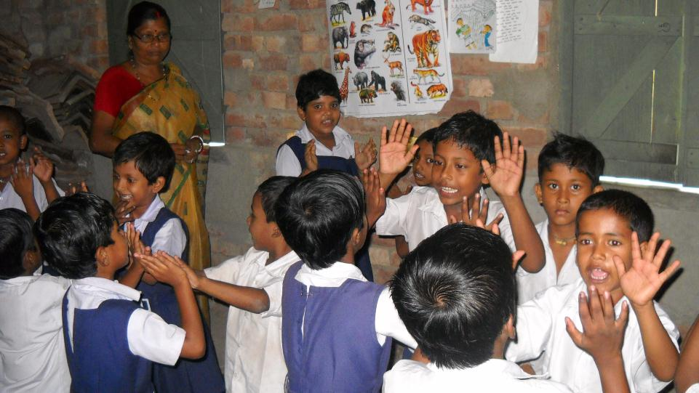
SWANIRVAR INTERVENTION IN GOVT SCHOOLS – 2015-16
ACTION RHYME IN GOVT PRIMARY

Slide 17
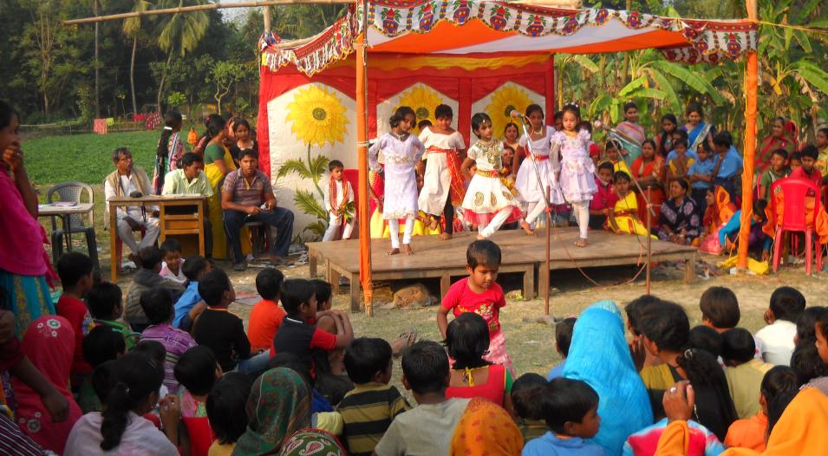
SWANIRVAR INTERVENTION IN GOVT SCHOOLS – 2015-16
SAHITYA SABHA IN GOVT PRIMARY

Slide 18
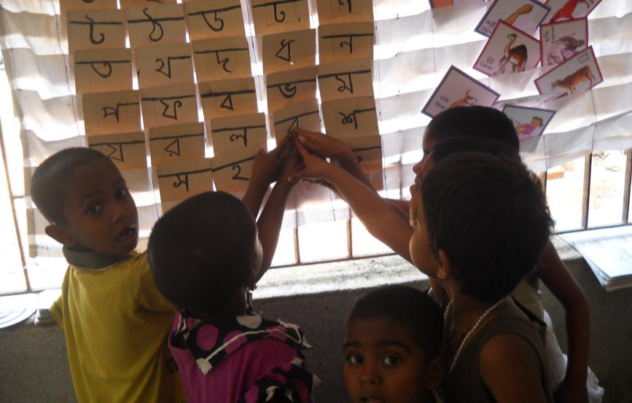
SWANIRVAR INTERVENTION IN GOVT SCHOOLS – 2015-16
USE OF CHART & POSTER IN GOVT PRIMARY

